Slide 1
Tender Briefing Event
29th July 10:00 to 11:30 (CEST)

Slide 2
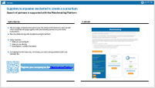
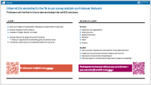
Technical: Questions, slides etc.
All information will be shared
During event
After Event
This meeting is recorded (including Q&A)
Video and mics will be opened for participants during Q&A
Please unmute yourself and turn on video when speaking
Present yourself in Chat with name, what you “offer”, contact details
Someone has to make the first step … so contact people (all you could hear is a no)
Ask anytime using Q&A function (not Chat!)
  We try to pick up on questions during presentation to degree possible
  If we do not, there is a very good chance your question will be answered on slides
Q&A will be live following questions and questions asked live
Critical / new questions are added to FAQ on website
Q&A are recorded
Presentations will be shared on website: https://suhco.eu
  All registered are notified via email
Recording will be shared on website
Suppliers/companies should register on Matchmaking Platform
Health and care organisations can become Follower
All are invited to newsletter and LinkedIn
Video, microphone, recording
Presentation
Networking
Staying informed
Questions
Notes:
Focus on instructions on left – the right part will be repeated on final slides

Slide 3




Objectives
Introduction
To understand the scope of the project and discuss suHCO challenge
To provide overview of Tender Documents
To explain how tender documents relate to each other
Q&A with participants

Slide 4




Presenters
Introduction
Maria Colomé
Project Manager
Klaus Piesche
Senior Research Consultant

Slide 5
suHCO Introduction and Context
What is the project about and who are we?
>> suHCO Introduction and Context
Tender Summary
Expected outcomes during Project
TD2 Challenge Brief
Technical Application Template TD6
Next Steps

Slide 6



Introduction
suHCO procurers
Catalonia
CSC (Consorci de Salut i d’Atenció Social de Catalunya)
Treviso
EnEA (Ente Educazione e Assistenza)
Wales
HDUHB (Hywel Dda University Health Board)
Supporting partners
empirica (Communication and Technology Research)
Bevan Commission (Swansea University)
BME (German Association of Materials Management, Purchasing and Logistics)

Slide 7
Project
Introduction
Leading health and care organisations are tackling a common challenge together
Project info
Pre-commercial procurement
3 Procurers – representing a diverse group of HCOs¹, providing services to 6.4 million clients
PCP
A wide-reaching Follower Network
Budget spent in a 3-phase competition
Prior Information Notice (PIN)
OJ S 208/2025 29/10/2025
Common Challenge: accelerate the sustainability transition in HCOs
€ 2,860,000
Investment in R&D!
1. The term ‘health and care organisation’ (HCO) is to include any organisation in health and care systems which has control and over and therefore the ability to reduce the environmental footprint of the sector. This includes but us not limited to hospitals, care homes, networks or groups, central procurement, cascading organisations etc.

Slide 8
Core elements of our challenge
suHCO aim and Scope
We defined the challenge along four building blocks
Area
Information
Operation
Organisation
Change & Upskilling
One place where local economy and HCOs can exchange on newest developments, funding and changing needs
Needs
Improved access to sustainable case studies, legal and procurement knowledge
Structure and guidance for sustainable action to achieve operational effectiveness
One platform to increase efficiency of the organisation in conducting sustainable action
Customised capacity-building
and training

Slide 9
PCP structure
suHCO : PCP Structure
PCPs follow a multi-staged process to select the most suitable and promising innovation; R&D services are funded at all stages
Applied R&D / Pre-commercial Procurement (PCP)
Public Procurement of Innovative Solutions (PPI)
Phase 0
Curiosity
Driven
Research
Open
Market
Consultation
Call for Tenders
Call open for
industry
participation
Phase I
Solution design
Phase II
Prototype development
Phase III
Original development of limited volume of first test products / services
Phase IV
Deployment of commercial volumes of end-products
[OUTSIDE OF suHCO SCOPE]
Supplier A
Supplier B
Supplier B
Supplier C
Supplier C
Supplier B
Supplier D
Supplier D
Supplier E
Supplier D
10 Months
3 Months
+2 Process
4 + 1 Months
x
€ 572.4k PCP budget*
5 Suppliers (TBC)
€ ~114.5k each
7 + 1 Months
x
€1,144.8k PCP budget*
3 Suppliers (TBC)
€ 381.6k each
11 Months
xx
€1,144.8k PCP budget*
2 Suppliers (TBC)
€ 572.4k each
Sep. 25
Jul. 26
Dec. 26
May 27
Jan. 28
Dec. 28
*All PCP budget values stated are expected to include VAT (21%). The maximum PCP budget for a successful Supplier (participating in all three phases) equals € 1,068,480
Notes:
We currently finished in Phase 0, which is where we developed the final requirements and the tender documents
Following the evaluation of the call for tenders (timeline will come on a separate slide) Phase I largely happens on paper and focuses on the feasibility, design, and risk assessment of competing solution concepts. This is where five suppliers get funded to design their approach. You get about €114000 each and four months, plus one transition month. Think of it as the audition round. Everybody gets a shot
Phase II translates three selected concepts into working prototypes, The budget per supplier goes up to roughly €380000, and you have seven months plus one. This is where you actually build something. No more PowerPoints — well, fewer PowerPoints.
while Phase III provides 570k€ to two final suppliers to tests and validate these solutions in real-world or near-operational conditions.
And Phase IV? That's commercial deployment but that's outside of suHCO's scope. That's your future. That's where you take what you've built and hopefully sell it to the health and care organisations across Europe, you may remember the slide Maria presented on the 32 members of our Follower Network, so there is a real market.
So yes this is a funnel. But it's a funded funnel.

Slide 10
Tender Summary
Overview of Tender Documents
suHCO Introduction and Context
>> Tender Summary
Expected outcomes during Project
TD2 Challenge Brief
Technical Application Template TD6
Next Steps

Slide 11
Tender documents (TDs) overview
Tender summary
We did our best to make it transparent and avoid duplication; however, it is a large contract and will be some effort
Phase | Description | Documents
Call for Tenders | Central documents on conditions, content and challenge | TD1 Call for Tender TD2 Challenge Brief (includes Annexes)
Proposal to be submitted | Administrative Forms to be filled by tenderers | TD3a Declaration of Honour - Exclusion Criteria TD3b Declaration of Honour – On/off Award Criteria TD4 Power of Attorney
 | Application Templates to be filled by tenderers | TD5 Tender Application Template – Administrative TD6 Tender Application Template – Technical TD7 Tender Application Template – Financial
Project | Contract Templates to be signed by successful contractors | TD8 PCP Framework Agreement TD9 PCP Specific Contract for Phase I-II-III
Depending on your
role you read one or
the other first
It should be extensively streamlined but if you have questions or ideas, please let us know
Though TD1 contains key terms, there is more detail here

Slide 12
Tender documents (TDs) overview
Tender summary
Call for Tenders: procurer input
Submit with your tender
Signed if you win
Call for Tenders,
TD1
Challenge Brief
TD2 + annex
Tender Application Template
Technical
TD6
PCP Specific contract for phase I-II-III
TD9
Tender Application Template
Admin
TD5
Tender Application Template
Financial
TD7
PCP Framework Agreement
TD8
Declaration of Honour
TD3a/b
Power of Attorney
TD4
Notes:
Point 1: if you're still deciding whether to bid, you don't need to read TD6 or TD8 yet - read TD1's eligibility and exclusion sections first, plus TD5, that tells you fast whether you're in scope.
Point 2: For understanding what to build, read TD2, especially the four building blocks, cross-cutting requirements and the use cases.
Point 3: Writing your technical offer. TD6 isn't a free-form document, every section title corresponds to a scored sub-criterion in TD1. Write to the structure you're given.
Point 4: don't skip the VAT explanation in TD1, we've had questions on this in past PCPs - prices are submitted net of VAT, and the maximum budget figures in TD1 are VAT-included, so do the maths before you finalise your number.

Slide 13
Expected outcomes during Project
Section 2.1.2 in TD1
suHCO Introduction and Context
Tender Summary
>> Expected outcomes during Project
TD2 Challenge Brief
Technical Application Template TD6
Next Steps

Slide 14
The challenge, in four parts
One coherent AI-enabled platform covering four areas of need — described separately, but not separable.
Information
Operation
Organisation
Change & Upskilling
Find, trust and localise sustainability knowledge
Turn strategy into workflows, procurement and reporting
Coordinate across departments, suppliers, decision-makers
Build the skills and habits that make it stick
suHCO | Bidder Webinar
4
Notes:
These four areas are interdependent, a strong proposal treats them as one system, not four modules bolted together.
A nurse finding a greener supply option (Information) only matters if it turns into a procurement workflow (Operation), gets signed off across departments (Organisation), and staff actually use it (Change & Upskilling). A tender that nails one block and treats the others as an afterthought will potentially score worse under Excellence than one that shows how all four connect - see Award Criterion E1 in TD1.
Full detail, including the field research behind these four areas - the survey, focus groups, persona work - is in TD2, the Challenge Brief. That document is your primary source for understanding what we actually need.

Slide 15
Expected outcomes, phase by phase
TD1 defines the deliverables. TD2 explains the substance behind them.
Phase I
Phase II
Phase III
Design
Prototype
Pilot
A validated solution design and Co‑Design plan for all three pilot sites - not a working system yet.
A tested prototype, evaluated with end‑user groups at each site. Usability and technical feasibility evidence.
Operational piloting at all three sites, with measured impact against site baselines; the evidence base for post‑PCP follow‑up.
Co‑Design starts in Phase I: the Buyers Group facilitates access to end‑users at each pilot site from day one, not just during testing in Phases II and III.
suHCO | Bidder Webinar
9
Notes:
Phase I is not a prototype, it's a design - don't over-build in Phase I, we're assessing the thinking, not a working demo.
From Phase I onward we will try to actively organise access to real end-users at all three sites for you - nurses, procurement staff, sustainability managers. This isn't something you have to arrange cold yourselves, but it is something you need to plan for in your Phase I work plan. TD6 asks you to describe how you'll use that access.
On testing in Phases II and III: end-user groups combine clinical/care staff and procurement/administrative staff at every site, usability is assessed against defined methods - just flag that it's there and specific in TD1 2.1.2.

Slide 16
Deliverables
Expected outcomes
Table 1 (of TD1 (2.1.2)) describes the progress on R&D documented in the deliverables depicted below
Tender
Phase I
Design & Feasibility
Phase II
Prototype Development
Phase III
Pilot Systems & Real-Life Testing
Graphic represents evolution of key documents to be delivered
Offers
Technical
offer
(based on TD6)
Offer for
Phase II
Offer for
Phase III
Core
solution
SD1.1
Improved
solution design
SD2.1
Prototype v1
key components
SD2.2
Functional
prototype v2
SD3.1
Development
progress
SD3.2
Pilot presentation &
connection testing
Pilot operation
& evaluation
M1.1
M2.1
M2.2
M3.1
M3.2
M3.3
M3.4
Testing &
validation
SD2.1a
Testing
protocol v1
SD2.2a
Testing
protocol v2
On-site
testing
Real-life
pilot
evaluation
Feasibility
& approach
Compliance
SD2.4
GDPR
compliance
GDPR requirements
applied in pilot
Reflected in final
system documentation
Requirements
in design
Reports &
publication
SD1.2
Public
abstract
SD1.3
End-phase
report
SD2.3
Public
abstract
SD2.5
End-phase
report
SD3.4
Public
abstract
SD3.3
Final report +
system documentation
SD3.5
Lessons
learned
Interim / supporting output
Final / mandatory output
Milestone
Notes:
This slide is basically your homework schedule for the whole PCP, TD1’s Table 1 section 2.1.2, just turned into something you can actually look at instead of parsing out of a contract clause. Which, let's be honest, is a low bar to clear, but here we are.
You've got four phases running left to right - Tender, Phase I Design & Feasibility, Phase II Prototype Development, Phase III Pilot Systems & Real-Life Testing - and five rows underneath tracking what's actually being produced along the way: Offers, Core solution, Testing & validation, Compliance, and Reports & publication.
Start at the top. The green "Offer" boxes are the gates - you submit a Technical Offer based on TD6 to get into Phase I, then have to submit again to advance into Phase II and again into Phase III. This isn't a "sign once, coast forever" contract. You have to keep earning your spot, phase by phase - which, frankly, is the entire point of a PCP and also the reason this graphic has so many arrows in it.
Core solution row is where the real deliverables live - SD1.1 through SD3.2, tracking the design evolving from an "improved solution design" in Phase I, through functional prototypes in Phase II, to pilot presentation and connection testing in Phase III. The red boxes - M1.1, M2.1, M2.2, M3.1 through M3.4 - are milestones sitting right underneath.
Testing & validation runs in parallel underneath - protocols get defined, then tested, then it all culminates in real-life pilot evaluation in Phase III. Compliance is the row that's easy to skim past and shouldn't be - GDPR requirements get baked in during design, tested for compliance in Phase II, applied on-site during the pilot, and finally reflected in the final system documentation. In other words: it's not a box you tick once at the end, it's a thread running through the entire project. Anyone who treats GDPR as a Phase III afterthought is probably going to have a bad final report.
Bottom row, Reports & publication, is the paper trail - public abstracts and end-phase reports at the close of each phase, building up to the final report, system documentation, and lessons learned at the very end.
Net effect: this is the entire supplier journey on one page - offer, build, test, comply, report, repeat, three times, with the bar rising at each phase gate.

Slide 17
TD2 Challenge Brief
Common challenges of HCOs to transition to sustainable healthcare delivery
suHCO Introduction and Context
Tender Summary
Expected outcomes during Project
>> TD2 Challenge Brief
Technical Application Template TD6
Next Steps

Slide 18
Desired Innovations (simplified)
TD2 Challenge Brief
The areas of need require digital innovation and CE expertise
Operation
  Plan, implement, track, procure and finance sustainable action
Information
Change & Upskilling
  Access to sustainable knowledge, evidence, criteria and rules
Behaviour change and capacity building
Coordination across departments, providers and decision-makers
Organisation
Notes:
The third time I say this sentence, so it might be somewhat important: These four areas are interdependent, a strong proposal treats them as one system, not four modules bolted together.

Slide 19

suHCO is technology neutral
TD2 Challenge Brief
Our focus is to describe the actual problem – you need to come up with technical and practical solutions
Suppliers define the solution
Buyers Group defines a
(very complex) problem and award criteria
…any constellation of technologies is thinkable if it fulfils design principles and requirements etc. …
Notes:
TD2 includes a whole lot of Annexes – User personas, use cases, process models, user journeys, storyboards, taxonomies, policy frameworks etc. Make use of this material in your tender!

Slide 20
Technical Application Template TD6
Structure of Weighted Award Criteria in TDs
suHCO Introduction and Context
Tender Summary
Expected outcomes during Project
TD2 Challenge Brief
>> Technical Application Template TD6
Next Steps

Slide 21
The Challenge = tender: TD2
Tender Application Template - Technical
The Challenge is structured along the Award Criteria as is the tender/proposal you are going to write
Call for Tenders
TD1
Challenge brief
TD2
Tender Application Template
TD6
(Weighted) Award Criteria
Challenge Brief
Tender Application Template
TD1 Call for Tenders, Section 3.4 and 3.5 include:
Maximum points
Thresholds & weights
Assessment scheme
Formulas
TD2 Challenge Brief includes:
Challenge description for each criterion
Minimum requirements as Must or in bold (in bullet lists)
Aspects relevant for assessment
Annexes
TD6 Tender Application Template - Technical includes:
Pre-defined sections, sub-headings and some standardised tables
Notes on expected content
Notes:
Start from the right: TD6 includes, that map to TD2, which maps to TD1

Slide 22
Award criteria weight shifts as the PCP progresses
100 points total in every phase. What earns them changes: intent in Phase I, evidence by Phase III.
Excellence
Soundness and novelty of the proposed approach
40 → 20
Impact
Benefits, cost, business model, scalability
35 → 50
Implementation
Work plan, governance, resource adequacy
25 → 30
80% quality score + 20% price score = final tender score
suHCO | Bidder Webinar
8
Notes:
Excellence shrinks because by Phase III we're not interested in how elegant your concept sounded on paper anymore, we’ve hopefully seen it running. Impact grows because that's the whole point - by Phase III we want to see measured outcomes at three real pilot sites, not projections. Implementation holds roughly steady because delivery discipline matters the same amount throughout.
Full scoring tables, including sub-criteria and thresholds, are in TD1 3.4.2.

Slide 23
Next steps and Q&A
suHCO Introduction and Context
Tender Summary
Expected outcomes during Project
TD2 Challenge Brief
Technical Application Template TD6
>> Next Steps

Slide 24
Tender Events (online)
Next Steps
suHCO organises tender dissemination events to help suppliers with tender submissions
Tender Training event: I
29 July
10.00 - 11.300 (CET)
Tender training event: II
21 September
10.00 - 11.30 (CET)
Registration
Open sessions for questions
TBD
TBD
Open
Phase I
Dec ‘26 – Apr. ‘27
Phase II
May. ‘27 – Dec. ‘27
Phase III
Jan. ‘28 – Nov. ‘28

Slide 25
Key Dates
Next Steps
Can be found in TD0 as well
Tender publication on TED and tender platform
July 2026
Deadline for submitting questions on tender documents, in writing only
18 September 2026
Deadline for publication of replies to questions (Q&A)
28 September 2026
SUBMISSION DEADLINE for tenders 14:00 CET
09 October 2026
Tenderers notified of evaluation outcome
Late November
Notes:
I’d like to emphasise the written-question point - it's not bureaucracy for its own sake, it's what keeps the process fair. If you email me directly with a substantive question, I will ask you to resubmit it through the channel so everyone sees the same answer.

Slide 26
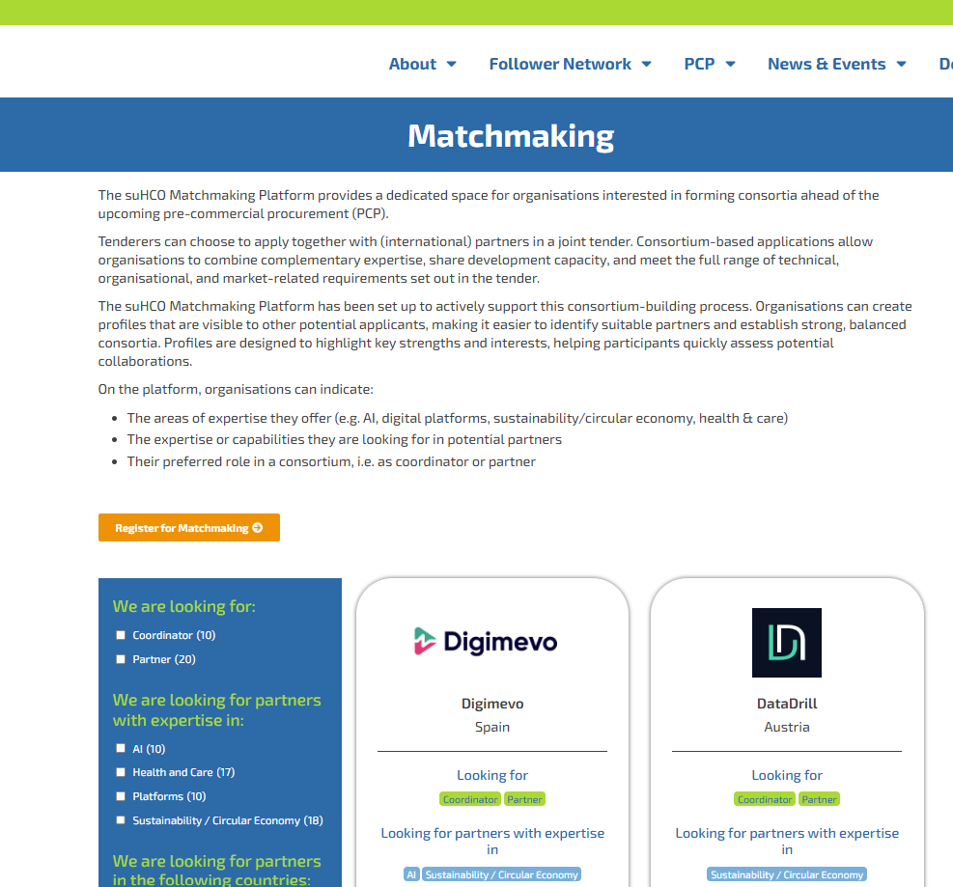
Suppliers are invited to create a consortium
Next Steps
Next steps
Matchmaking
Platform
Become visible among other suppliers looking for partners
Steps, describe:
  What you are looking for
  What you are offering
  Some basics + contact information
Completing the form takes only ~5 minutes
We encourage companies that cannot cover the whole envisaged suHCO solution to team up with other companies and apply together with international partners in a joint tender (consortium).
Matchmaking | suHCO PCP
Company A
Company B
+ As of 10 January 2024
Notes:
Matchmaking: worth a genuine plug, especially for smaller bidders - if you have strong AI capability but no local presence in one of the three countries, or vice versa

Slide 27
Suppliers: The “usual” steps to bid
Next steps
Read and do some form of gap analysis
Build consortium
Create an outline and concept – write and iterate
Ensure all formal steps & submit in time

Slide 28
Procurers are also busy
Next steps
We answer your questions
We prepare the evaluation (also during project)
We grow & inform the Follower Network > if you are an HCO, write in Chat / any of us
We work on the CE Taxonomy
We inform about results end Nov 2026 – Phase 1 starts a couple of weeks after information

Slide 29

We go through Q&A
We unmute everyone – please raise hand
Ask anything – sometimes we will refer to
a section or upcoming event
Any new question will be added to FAQ

Slide 30
suHCO.eu
suHCO project
suHCO@empirica.com
emp.onl/suhco-news
Funded by the European Union’s Horizon Europe Pre-Commercial Procurement Programme
under Grant Agreement n° 101226802.

